Slide 1
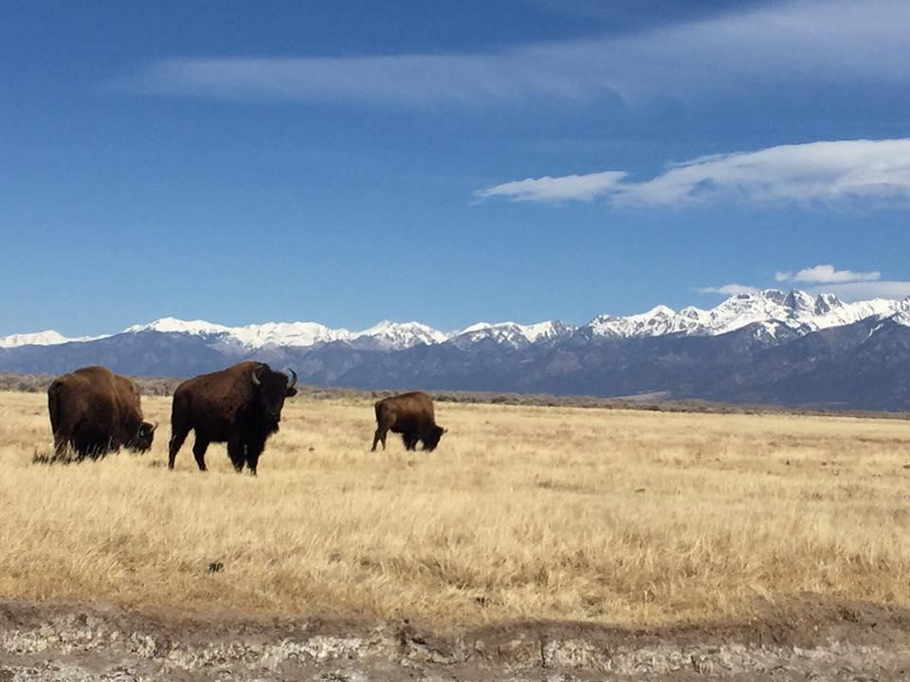

Community Recovery
May 8, 2020
Delta County & Municipalities
Kate Guibert
Rural Prosperity Manager
Colorado Resiliency Office
kate.guibert@state.co.us
Notes:
Welcome to what is first of many discussion regarding recovery.

Slide 2
Local Gov’t and DOLA
DOLA’s role in disasters is to be a partner with Local Governments in order to support the needs of the Local Government
Notes:
We are all asking questions about what recovery looks like and we don’t have all the answers but DOLA is a partner with all of you as we look to define the new normal.

Slide 3
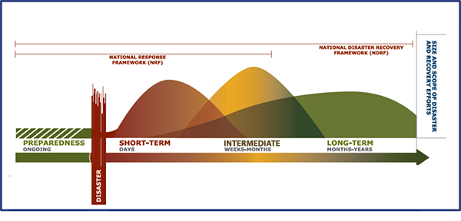
Recovery Continuum
Disaster recovery covers a spectrum of time, starting with activities that restore life support systems which address immediate needs and extends into re-building and re-development in a community which can take years.

Slide 4
Disaster Recovery
Traditionally, we think of disaster recovery as rebuilding or replacing critical infrastructure (roads, bridges, facilities) that has been destroyed due to a fire or flood or some other natural event.
This pandemic disaster has us thinking about how we rebuild our public health system and our economy.
Notes:
Something much harder to do because of the magnitude. We aren’t talking about a disaster that affected a community, we are talking about the entire State, US and world.

Slide 5
Disaster Recovery
The reality is, we can’t hit a reset button and go back to the way things were. This pandemic threatens to re-appear in subsequent waves over the next 12-18 months or until we find a vaccine.
We have to understand that the process most likely will result in re-shaping the characteristics of the community. (economically, culturally, environmentally) and it is important for us to think about how we adapt to a “New Normal” (Richard Florida)
Have you given some thought to what recovery looks like for your community?
Notes:
This will create challenges for us as we are in the process of developing recovery plans and strategies.

Slide 6
Form Your Recovery and Resilience Team
Who should lead: county/local government
Identify a lead Recovery Manager and build a communication plan to provide timely messaging as the community adapts to upcoming changes
Stakeholders should include:
  Elected officials
  Municipal and county staff
  Emergency management
  Public health
  Economic development organizations
  Members of the community who represent diverse industries/businesses
  Local chamber of commerce
  Any non-profits who support work locally and regionally
  Private sector technical experts - natural resources, lenders, tourism, etc.
Notes:
Bring the key sectors and movers and shakers. Diverse community representation and government
.

Slide 7
Community Recovery and Resilience Team Kick-off
Define roles
Determine your agency’s point of contact for cost recovery. Attend a FEMA/State Applicant Briefing.
What is the role of this team versus other stakeholders such as emergency responders, state and federal government?
    Example - role of recovery team is to share resources, identify assets, create communications structures, road map under different scenarios what will be needed to get up and running after a disruption, communicate needs to other agencies/organizations
  Define main points of contact for team coordination and event response and recovery
  Instead of damage assessment, conduct a survey of the challenges that lay ahead

Slide 8
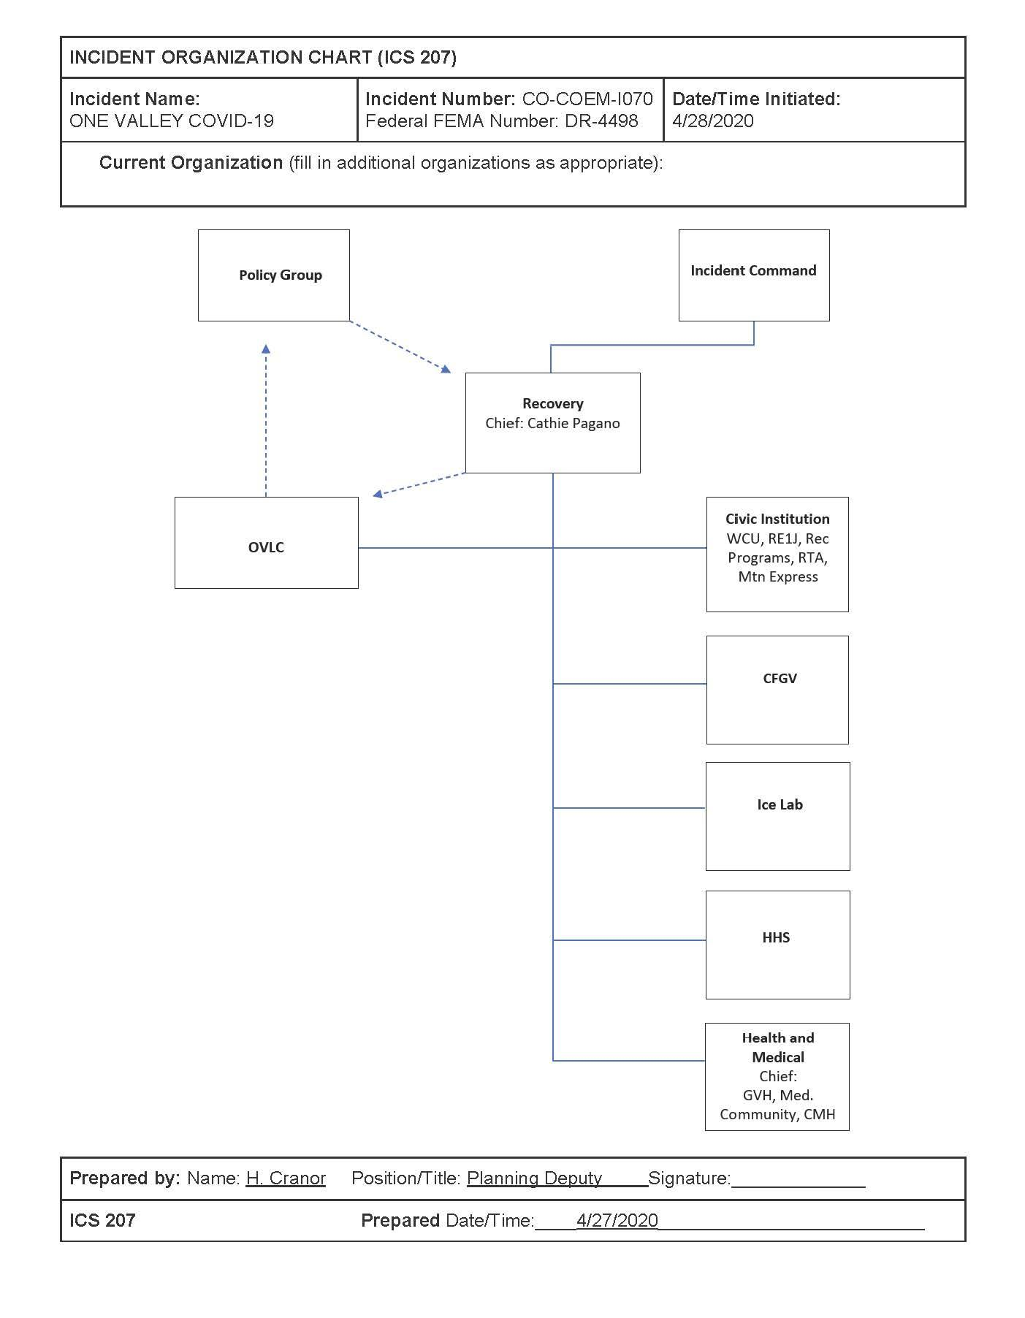
Gunnison County’s Structure

Slide 9
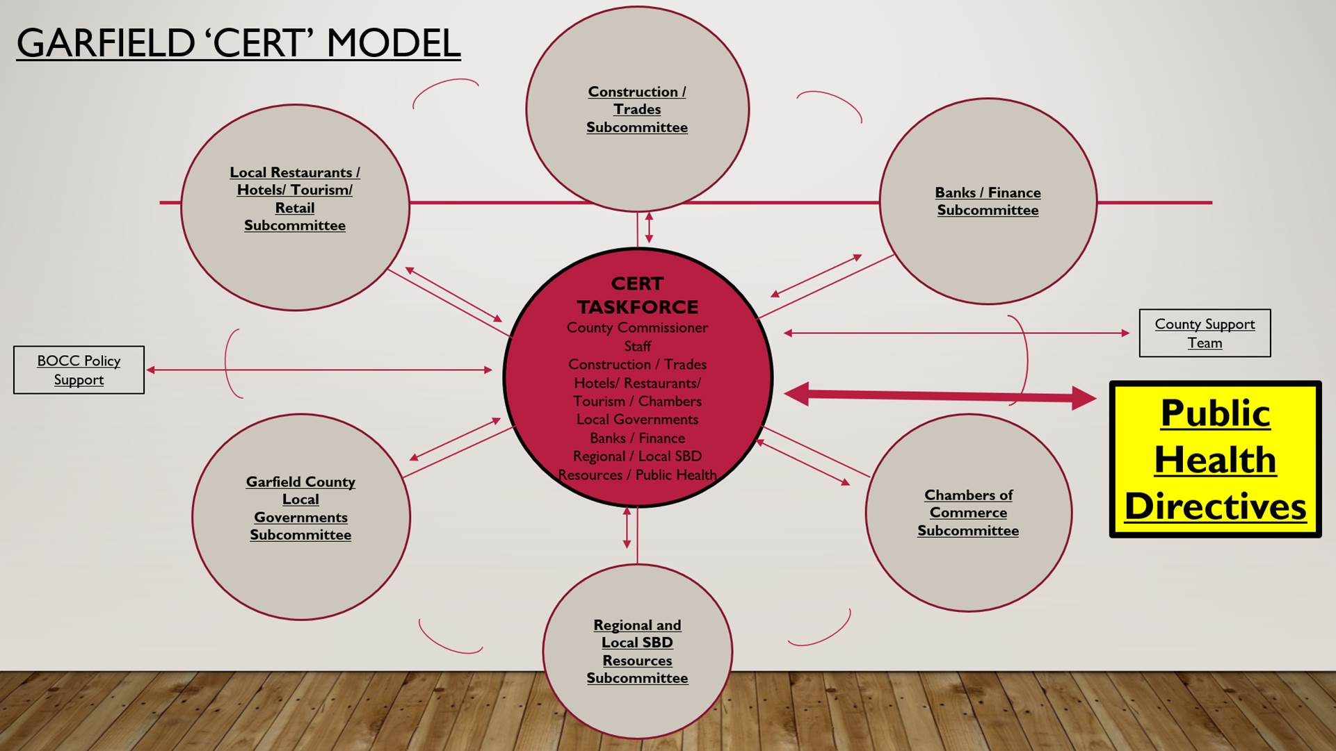
Notes:
Organization is important
Who is going to lead is important and communications is critical.

Slide 10
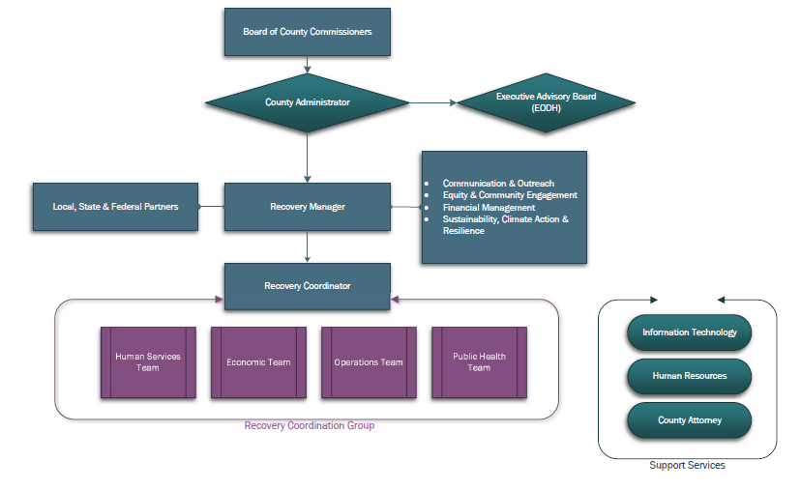
Boulder County

Slide 11
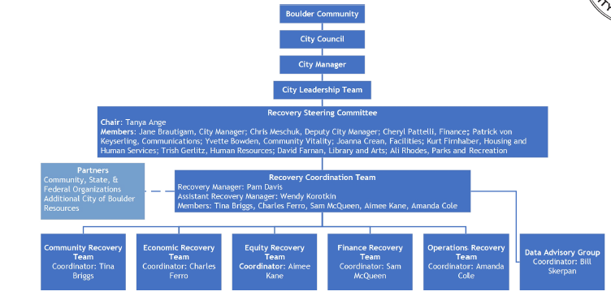
City of Boulder

Slide 12
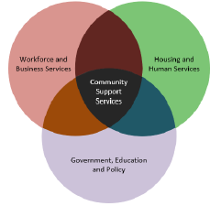
Larimer County 2020 Pandemic – Formation of Long-Term Recovery Collaborative
Recovery Group Structure:
Recovery Manager - (director of group, project management & communication)
Executive Board - (small governing committee & fundraising fiscal partner)
Task Forces - (each task force has a lead convener and area of focus has an elected official champion)
Subcommittees - (to be identified as needed by task forces)
Task Forces by Areas of Focus (cross-sector partners: county departments, private sector, municipal partners, non-profits, chambers, coalitions, community stakeholders)

Slide 13
Larimer County Structure
Workforce and Business Services
Small Business Support Task Force
Economic Development Task Force
Workforce and Employment Task Force
Agricultural and Farming Task Force
Housing and Human Services
Food and Essential Needs Task Force
Early Learning & Childcare Services Task Force
Housing Stability and Homelessness Task Force
Healthcare Access Task Force
Aging Adult Services Task Force
Government, Education and Policy
County Operations and Programs Task Force
Municipal Operations and Programs Task Force
K-12 Educational Systems Task Force
Higher Education Task Force
Community Support Services
Social Equity and Inclusion Task Force
Behavioral Health Services Task Force
Voluntary Agencies and Non-Profit Support Task Force

Slide 14
Model of Economic Recovery
Framework Intentions
A way to see the path forward:
  Thinking ahead 3, 6, 18 months and beyond
Structure and ideas
  Each community can customize, improvise
Dynamic
  Expect things to evolve weekly as conditions change
Notes:
Next, introduce a model or framework that might be considered.

Slide 15
Model Assumptions
3-6 month period of extreme disruption; 12-18 months resumption of most economic activity in phases
Background trends remain positive long term, yet pandemic will create shifts in many sectors
Framework for navigating the turbulence
  Short term Stabilization
  Recovery
  New Normal
Organizational Response – need to pivot resources, skills and approaches through each phase

Slide 16
Scenario Planning Model
Scenario/Phase planning empowers communities to take back control while things are still uncertain. Thinking about a few ways the future can unfold and considering actions under each scenario will make communities more prepared for any number of future conditions.
Steps for Scenario Planning:
Consider issues and opportunities under each scenario
Define strategies that address issues and take advantage of opportunities
Be mindful when developing scenarios that you consider existing conditions such as the Governor’s phase guidance and local Public Health Protocols (stricter/less strict depending on agreement with the State)
Take State and local guidance and turn it into actionable tasks that potentially require staff time, equipment, materials, alteration to operating procedures etc.
This approach can be tailored to different scales from community planning to individual businesses

Slide 17
Current Strategy
“Safer at Home” - Stabilization
60-65% social distancing maintained
Vulnerable populations and older adults must stay at home except when absolutely necessary
Increased protection measures, compliance and enforcement for Senior Congregate Care facilities
Increasing testing and aggressive contact tracing program
Building more healthcare capacity
Face covering wearing culture
Excellent hygiene at all times (hand washing)

Slide 18
Safer At Home Strategy – Maintain 60-65% social distancing
Tasks:
No group gatherings of more than 10 people
Critical businesses will remain open with strict precautions (social distancing, masks for all employees, more frequent cleanings, etc.)
Retail businesses may open for curbside delivery and phased-in public opening with strict precautions.
Nightclubs, gyms and spas will remain closed
Elective medical and dental procedures begin, with strict precautions to ensure adequate personal protective equipment and the ability to meet critical care needs
Personal services (salons, tattoo parlors, dog grooming, personal training, etc.) will open with strict precautions
K-12 schools and postsecondary institutions will continue to suspend normal in-person instruction for the 2019-2020 school year
Telecommuting continues for offices. Starting on May 4, up to 50% of staff can work in person (with social distancing in place)
The state is not changing requirements for nursing homes and other senior care facilities. There will continue to be restrictions on visiting residents
Notes:
These tasks will get us to the number of 60-65% social distancing. Your work is to design and resource this work towards recovery - From a simplistic standpoint we go from closed to open state (Recovery). Is this valid?
Resource Needs Plan

Slide 19
Recovery Discussion
What’s our vision for the community coming out of this?
What community values must be incorporated into the recovery process?
What are the pressing shocks and stresses facing the community? Prioritize them.
What steps can we take to address these shocks and stresses and build resilience?
How can available local, state, federal or non-government resources help achieve our vision for the recovery and for the community?
How can we empower the community to take charge of parts of recovery? Think about businesses, nonprofits, universities, creative and arts community.

Slide 20
Current Funding Opportunities
DHSEM
FEMA Public Assistance: Applicant Briefing April 23rd
EMPG supplemental funding – 4/28 (DHSEM)
DOLA - https://www.coresiliency.com/
CSBG: Direct Distribution
CDBG: Grants for Public Services and Public Facilities
FEMA
https://www.fema.gov/welcome-assistance-firefighters-grant-program 4/23
Dept. of Justice: Additional JAG Funding
OEDIT - www.choosecolorado.com/covid19
SBA: https://choosecolorado.com/covid19/

Slide 21
Additional Resources
Colorado is dependent on our small businesses and tourism. Guide small businesses to Colorado OEDIT for information on loans, debt relief, alternative funding and tourism help.
Businesses can access SBA assistance at: www.choosecolorado.com/covid19 and
DHSEM/BEOC: https://www.colorado.gov/cobeoc
Plan for behavioral health. A good place to start is Colorado Crisis Services at 1-844-493-8255 or text “Talk” to 38255
Help agricultural producers maintain visibility of the farm to market supply chain. Connect producers with USDA Service Centers for help. CSU Extension also has information.

Slide 22
Additional Resources
Individuals can get connected and find answers to many questions by calling 2-1-1 Colorado or visiting www.211colorado.org
Engage with voluntary organizations and encourage people to volunteer at www.helpcoloradonow.org
CDPHE (Main State COVID Site): https://covid19.colorado.gov/
CDLE: https://www.colorado.gov/pacific/cdle/covid-19-4
EnergizeColorado: https://energizecolorado.com/

